Slide 1
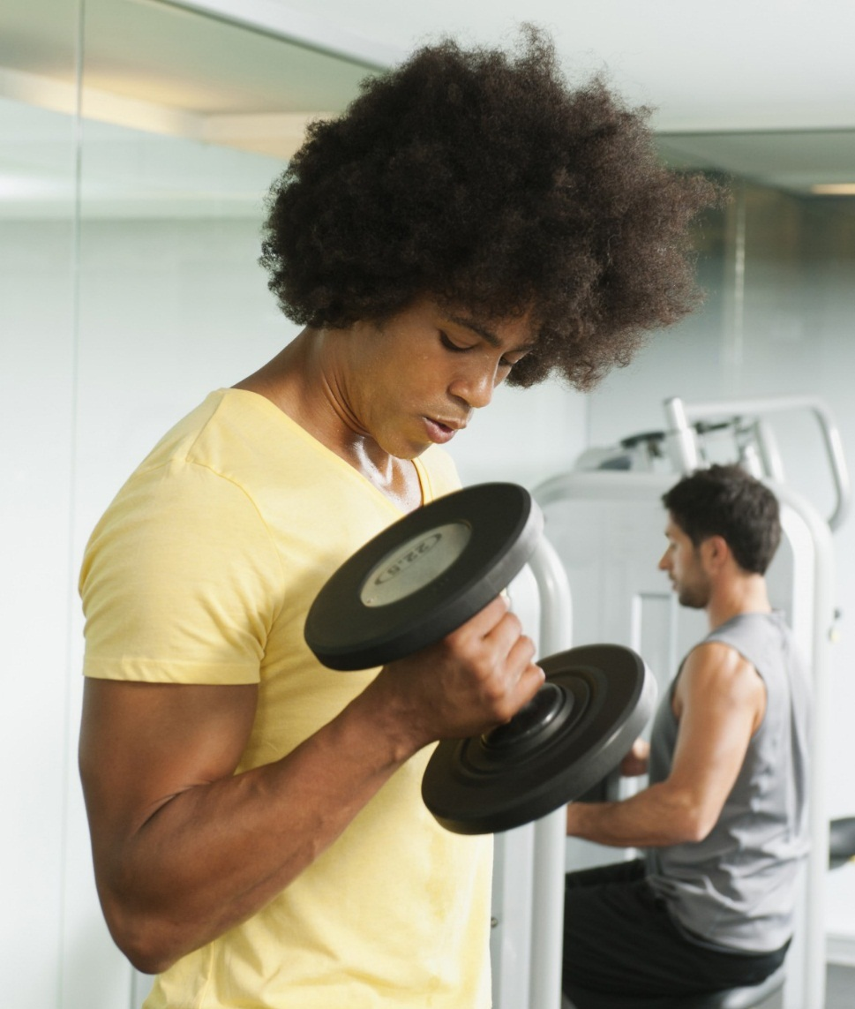
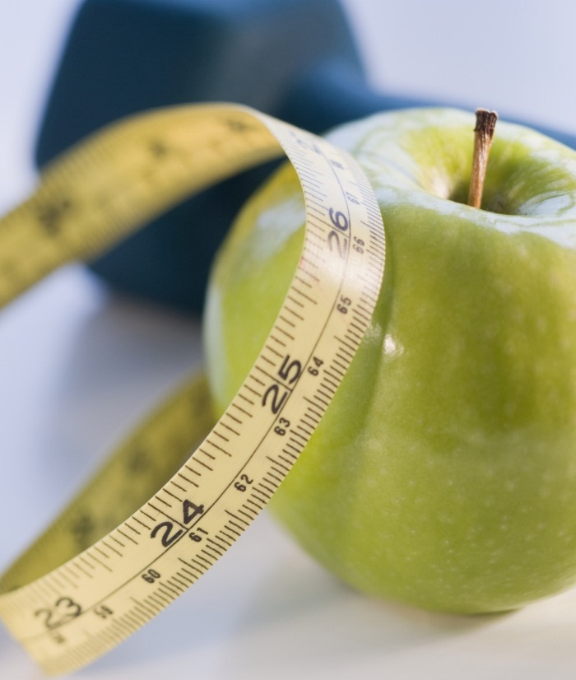
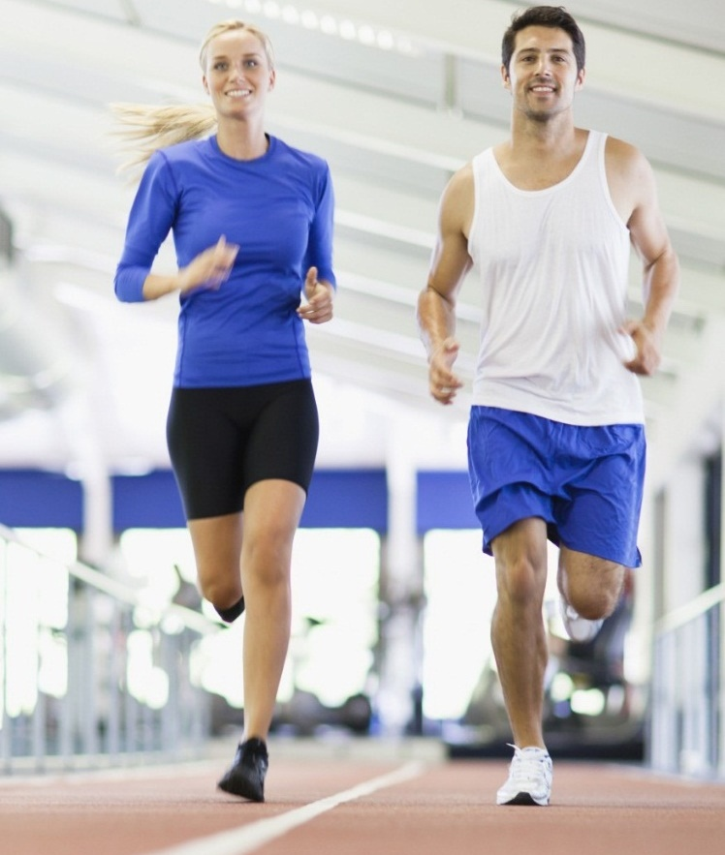

Healthees
Daniel, Glenn, Radhia, Carissa, justin

Slide 2
Roles & Contributions of group members
Daniel
Project leader: Responsible for the main application, management of group members’ job scope, weekly updates, reports and submission of project on time/before dateline.
Lead Programmer: Responsible for the entire application development of Healthees
Glenn
Documenter: Responsible to prepare PowerPoint slides for presentations, monthly progress reports, design documents and writing a formal report for submission
Radhia
Assistant Programmer: Responsible for the entire application development of Healthees
Carissa
Assistant Programmer: Responsible for the entire application development of Healthees
Justin
Assistant Programmer: Responsible for the entire application development of Healthees

Slide 3

Roles of the group members
NOTE:
To change images on this slide, select a picture and delete it. Then click the Insert Picture icon
in the placeholder to insert your own image.
Each member has different roles and tasks assigned to them. Their goal is to complete this goals. Members can also help others whenever they need assistance and guide.
Every member must update the group leader every week of the progress they had made and the leader must check every members work regularly, hence, this will make everyone work efficiently and not have to rush to do everything when near the deadline.

Slide 4
Purpose of the healthees application
Allows users to manage and organize their workouts and diets without having to rely on notepads and memory
It provides different workouts for average and overweight people to participate in.
It has programmes and activities for different age groups such as children, adults and even senior citizens.
The application is easy to use, reliable and convenient

Slide 5

FEATURES OF THE HEALTHEES APPLICATION
FEATURES
FEATURES
It is an application that can manage user’s health.
Users can update their weight, height and health particulars.
Users can calculate their BMI to see if they are overweight, underweight and average.
Workout plans are available for different age groups such as kids, adults and senior citizens.
Animations will guide users on how to perform the exercise carefully so that they can follow it and execute it safely.
Timers will challenge users to complete a set in the given duration.
Users can book appointments and pay at the application. This reduces the hustle and work as they do not have to queue very long on the clinic.
Users can choose which healthcare institutions, specialty centers, polyclinics they want to be consulted at
Users can choose which date & time they want to book the consultation. Hence, they can visit in their own time without adjusting their schedule for other things
The application also has a location feature which can see nearby hospitals and clinics. Users can then select one of these to go to without travelling very far
C
A
B

Slide 6
Target users/audience
People who has a passion for exercising
People who wants to maintain their fitness level
People who want to lose weight
People who wants to find out about diseases & illnesses
Doctors also are a target user as they can recommend this application to their patients so that they become aware of the different types of illnesses there are.

Slide 7
Application Requirements
The application must be user friendly and convenient to users.
The application must be able to navigate to different sections and pages for the user to use.
User’s must be able to edit and update their personal fitness information & progress.
The application should be able to manage and organize the user’s diet and workout plan
The application must be able to have animations on the workout plan to show users how to perform an exercise safely
The application must have a list of diseases to show users how to prevent getting them and should also show their symptoms
The application must have a guide on how to have a healthy lifestyle
The application must have a BMI calculator to see the user’s fitness level

Slide 8
Problems encountered
Problem #1
Android Studio has not been taught in previous semesters
Skills as a student are very limited. A lot of research has to be made online(Google) in order to complete a task
Not all of us are excellent in programming, hence, it resulted in a slower progress
Problem #4
Problem #3
The codes were very difficult to apply in Android Studio
Problem #2

Slide 9
Workable Solutions
Solution #1
We have to research and learn a new programming language to use Android Studio
Solution #2
We have to search independently and update each other if we have found reliable codes to apply to the application
Solution #3
We brought our own laptops and used the school computers to do most of the work. We saved and bookmarked websites that showed information we can use for further use
We watched many YouTube Android Studio tutorials

Slide 10




Project resources & softwares
Notes:
You can use this slide as your opening or closing slide. Should you choose to use it as a closing, make sure you review the main points of your presentation. One creative way to do that is by adding animations to the various graphics on a slide. This slide has 4 different graphics, and, when you view the slideshow, you will see that you can click to reveal the next graphic. Similarly, as you review the main topics in your presentation, you may want each point to show up when you are addressing that topic.
Add animation to images and graphics:
Select your image or graphic.
Click on the Animations tab.
Choose from the options. The animation for this slide is “Split”. The drop-down menu in the Animation section gives even more animations you can use.
If you have multiple graphics or images, you will see a number appear next to it that notes the order of the animations.
Note: You will want to choose the animations carefully. You do not want to make your audience dizzy from your presentation.

Slide 11

Why did we choose these resources to use for the application?
Android Studio will enable us to apply our idea of making an application that can manage the user’s health particulars and be able to identify if they are in the range of being in danger
Firebase can enable us to store user’s accounts. Whenever user’s creates an account, it automatically stores its contents inside our firebase database.
GitHub enables our group to do our application simultaneously so that we can work efficiently at a quicker pace.
Google enabled us to search for information and other output services such as backgrounds and pictures we can use for our project.
Notes:
After consulting a variety of sources, you will need to narrow your topic. For example, the topic of internet safety is huge, but you could narrow that topic to include internet safety in regards to social media apps that teenagers are using heavily. A topic like that is more specific and will be relevant to your peers. Some questions to think about to help you narrow your topic:
What topics of the research interest me the most?
What topics of the research will interest my audience the most?
What topics will the audience find more engaging? Shocking? Inspiring?

Slide 12
Project progress chart in %

Slide 13

What is in the application?
BMI CALCULATOR
Since our application will be used to keep track and manage user’s health, we thought of ideas to meet certain requirements and we implemented and applied it to the application to show them benefits of having a healthy lifestyle.
STEPS COUNTER
BOOK AN APPOINTMENT
WORKOUT PLAN
DIET PLAN
HEALTH PROGRAMMES
DIABETES RISK ASSESSMENT
Healthees

Slide 14
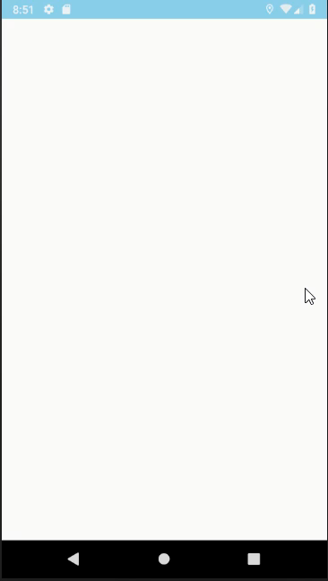
Welcome screen
In the welcome screen, we made it animated so that it can attract users to use the application. This is so that we can make a good first impression
The custom made Healthees logo that we made would pop up as well for 1.5 seconds

Slide 15
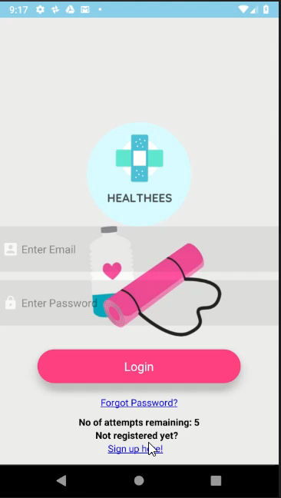
Register page
The register page is for users that will be using our application for the first time.
This would make it easier for the administrator to keep track of their account and their privacy
All of the registered users accounts would be stored inside our firebase database.

Slide 16
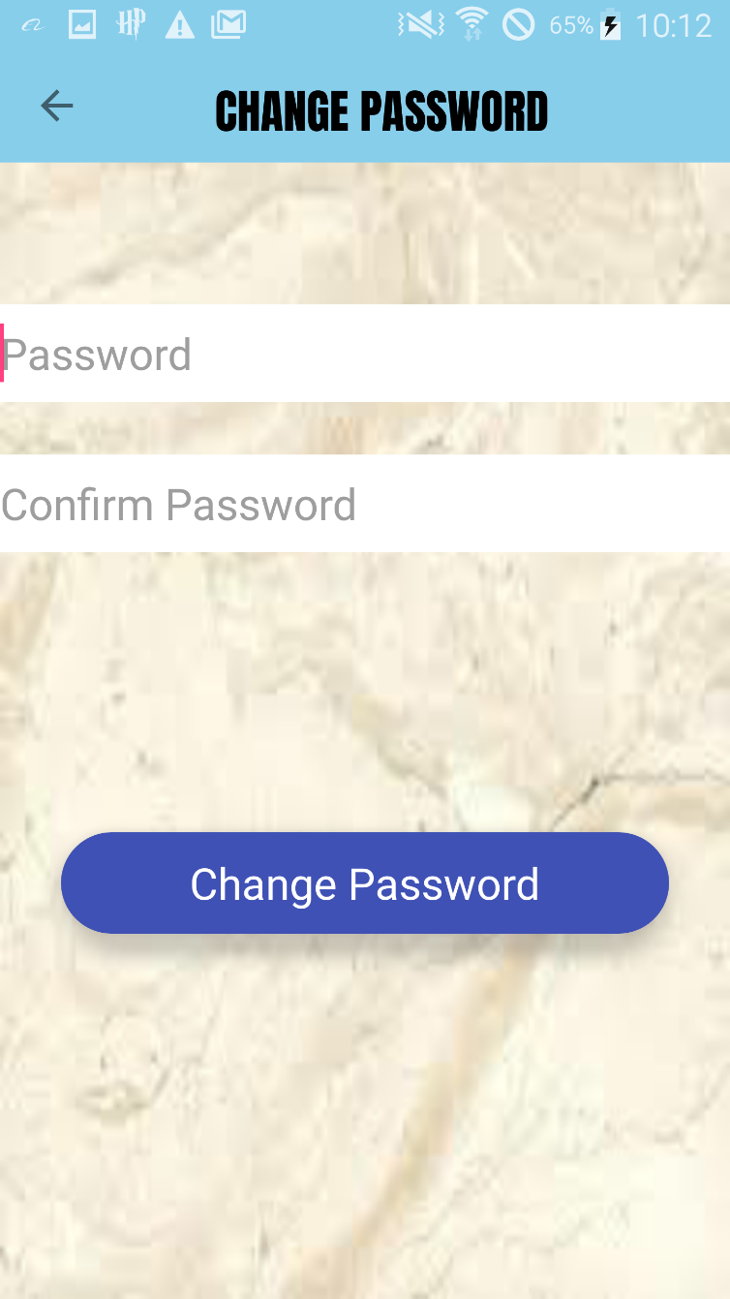
changing the password
The users can reset their password if they forgot their password
The users must check email to verify its user so that the user can change its password through email
By resetting the password, user can retrieve their account back

Slide 17
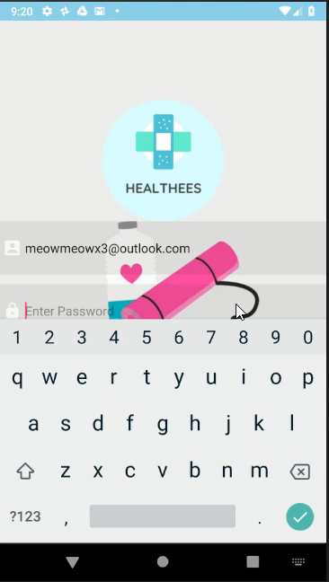
Login page
The login page enables the user to access the Healthees application using their account
They would fill their username and password in the textboxes provided for them.
To continue to the main page of the application, they would then have to click the login button.

Slide 18
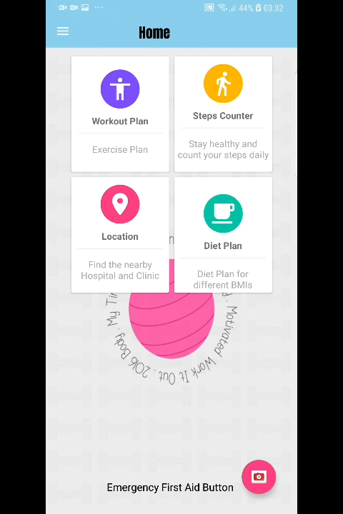
Home page
In the home page, users can select the workout plan to check out interesting exercises the application offers that supports activities for different age groups
They can select the steps counter to track and count their steps
They can locate nearby hospital and polyclinics by using the location feature
They can see different diet plans which can guide users on a weekly basis. This will give them better time and daily motivation to keep grinding on their diet schedule.

Slide 19
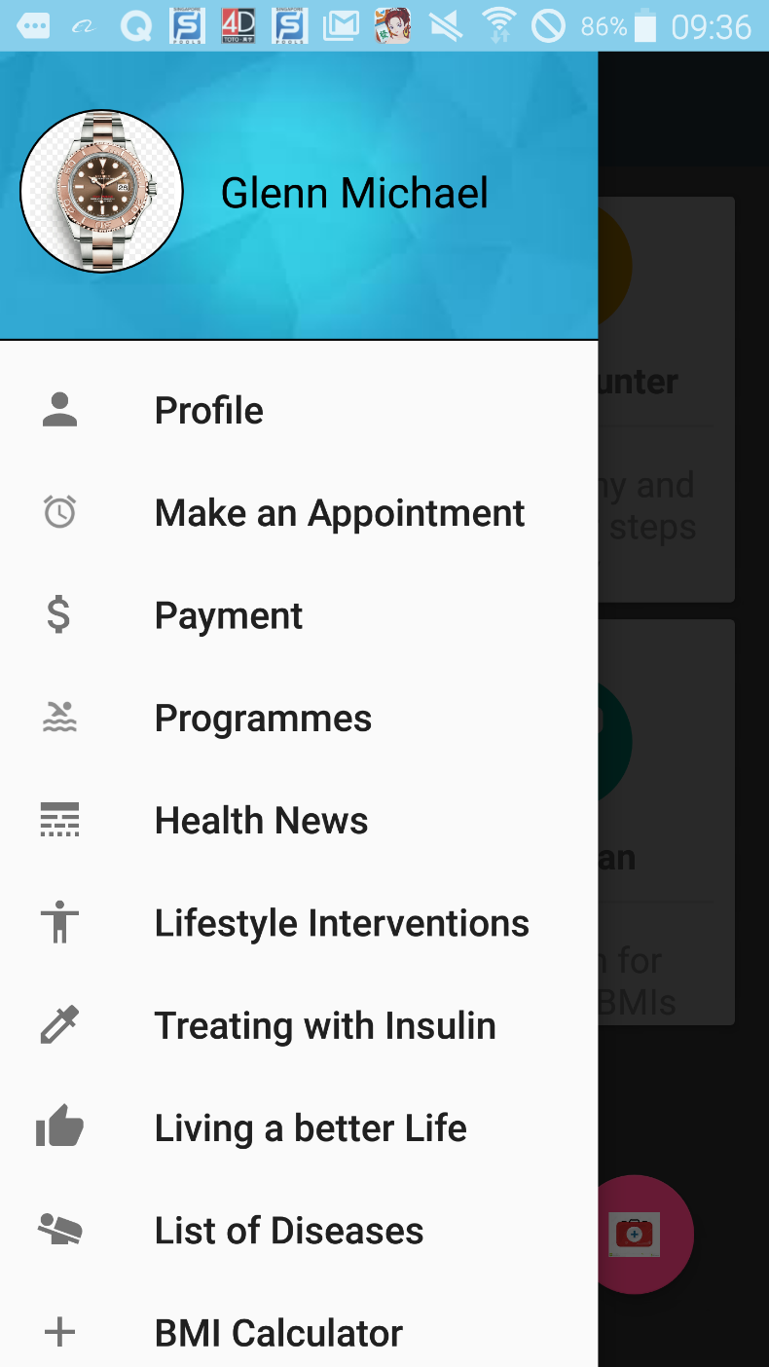
Application sections
In these page we will see the features that our application offers. This is where the users will be able to choose which of the features they would want to check out or find interesting. Users can also scroll down to sign out if they want to log in to a different account.

Slide 20
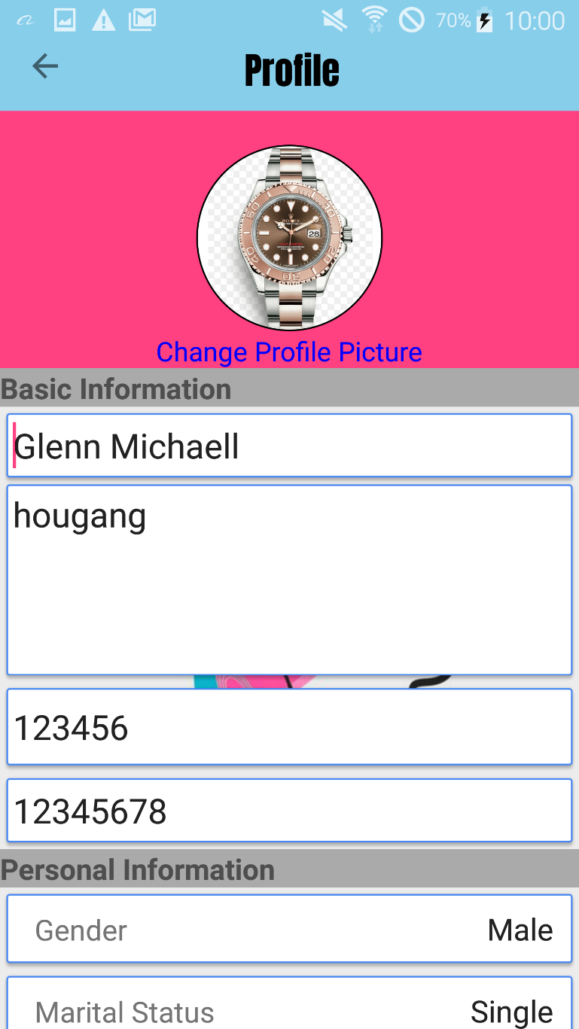
USERS PROFILE
At the top right corner there is an icon that can edit the user’s account particulars, they can edit their profile picture and update their personal details
They can also update additional information such as their gender, marital status and residential type

Slide 21
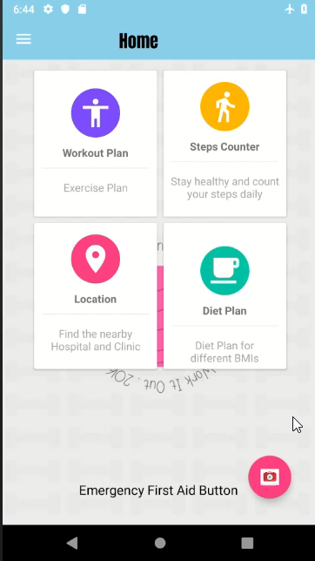
Emergency button
At the home page, there will be a emergency button at the bottom right corner.
The emergency button is used to call 995 if there is any emergency that is happening in the scene.
This benefit for people who are using the application or if they felt like they don’t know the number, they can use the emergency button to call.
After pressing, they will show a dialog asking if you really want to call the emergency.
Incase if anyone accidentally press the emergency button, the dialog will ask one more time if that person really wants to call the emergency.

Slide 22
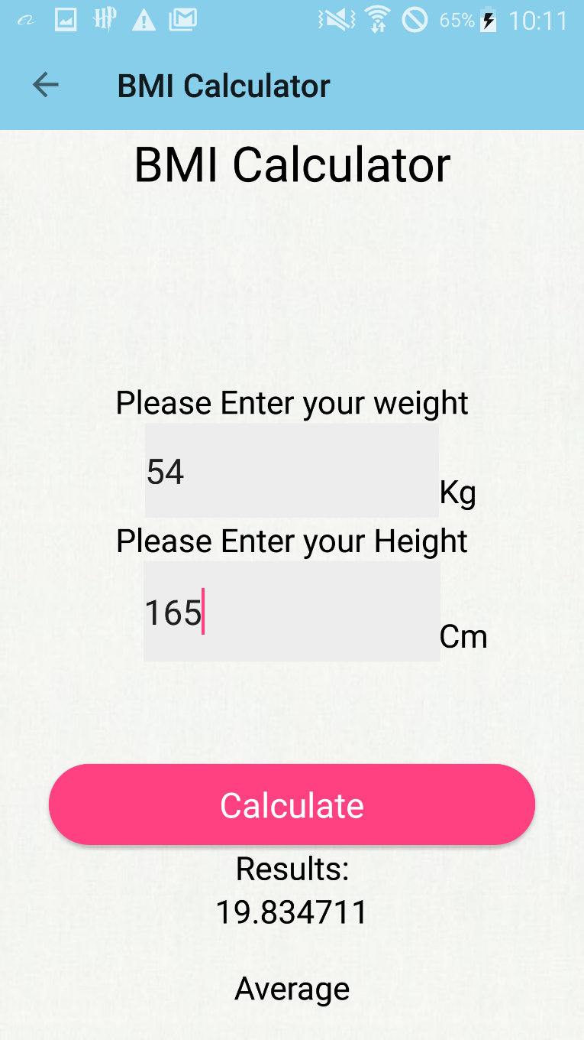
BMI Calculator
Users can use this to calculate and determine their BMI.
Once they entered their height(cm) and weight(kg) they can select the calculate button and their BMI result will be displayed below
There are 3 types of results, underweight, average and overweight. Users can then identify what kind of exercise they have to do and head to the diet and workout plans to set up their workout schedule.

Slide 23
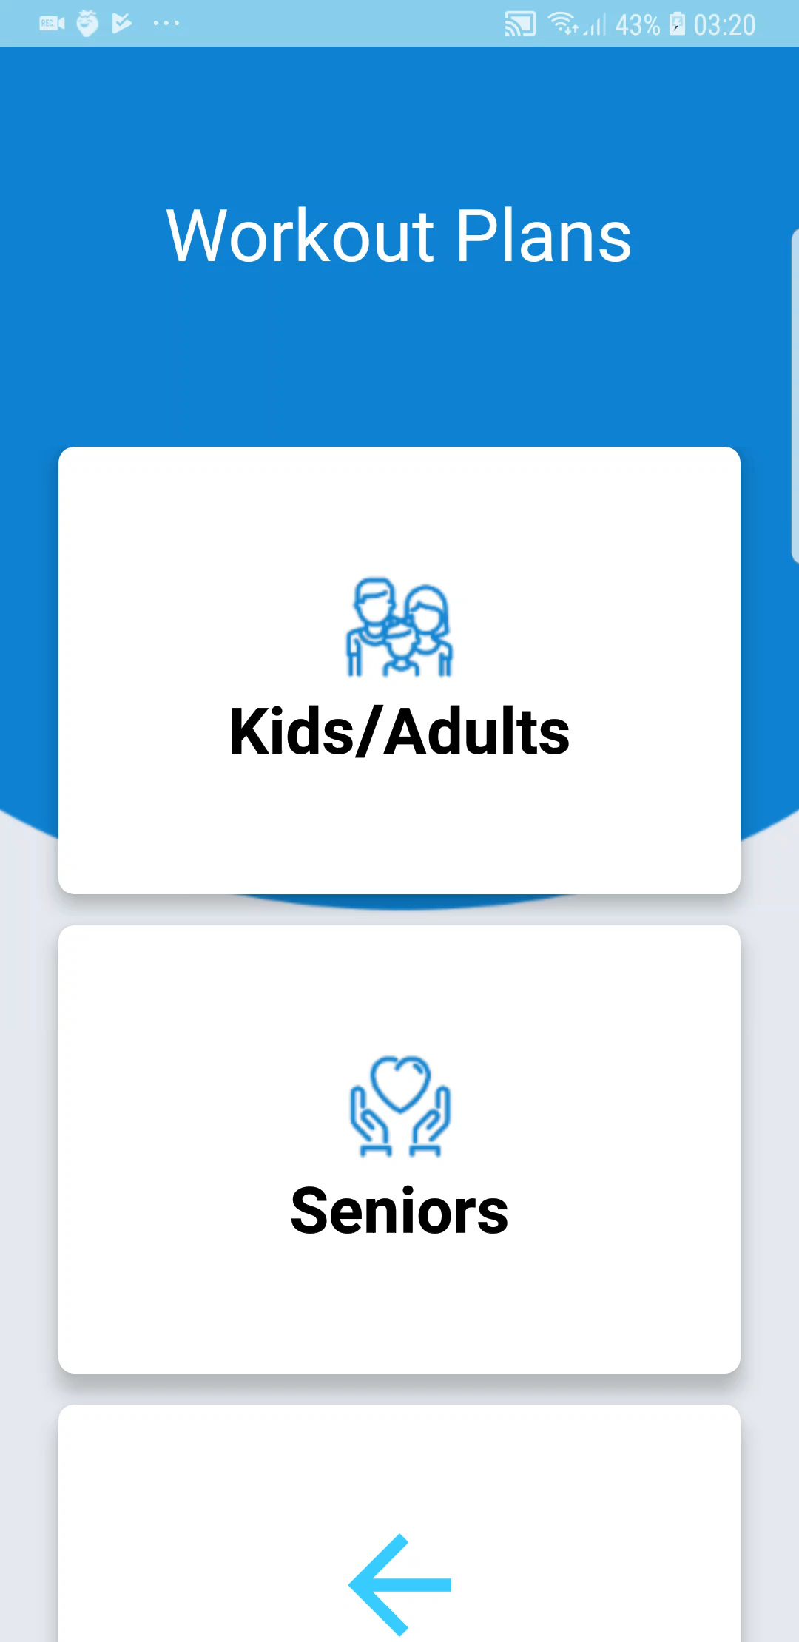
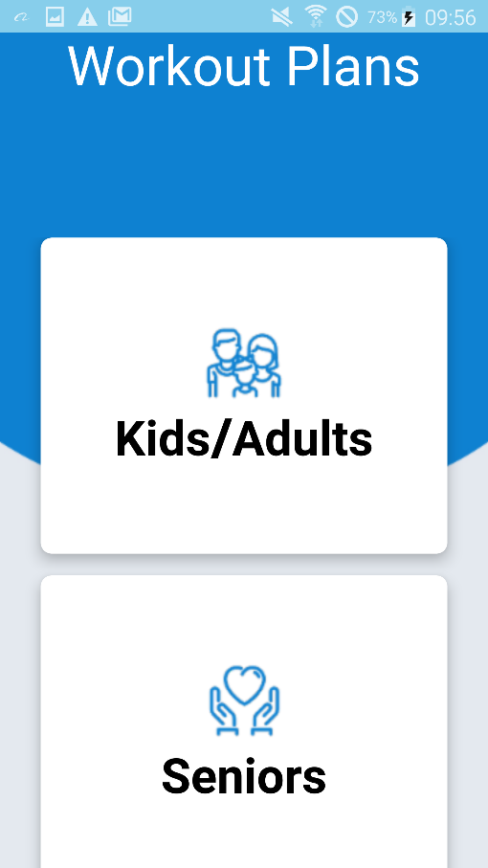
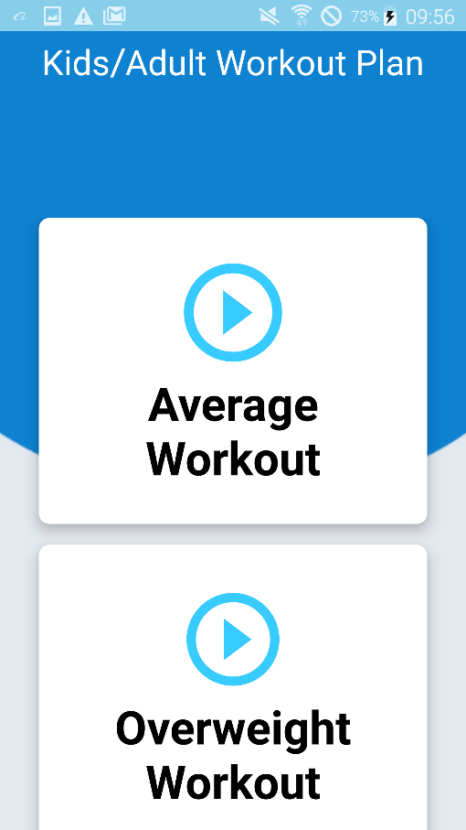
Workout plan
In the workout plan section, users can choose from different types of exercises, from three different age groups and it also has an average and overweight workouts
Kids and adult exercises offers more difficult training and requires more energy to be spent to keep them active and fit
For the seniors, however, will have more stretching and will focus more on joint exercise to keep them flexible and agile so that they will not feel joint pain. We also provide a schedule for their workout plan.
It has an average workout plan which can help users workout and stay fit
It also has an overweight workout plan which has a more rigorous training guide which helps overweight and obese people to start losing weight.

Slide 24
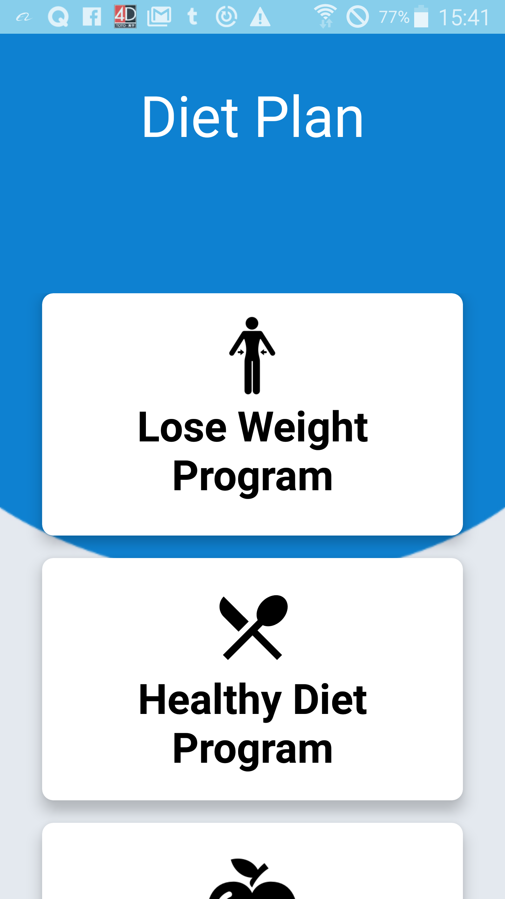
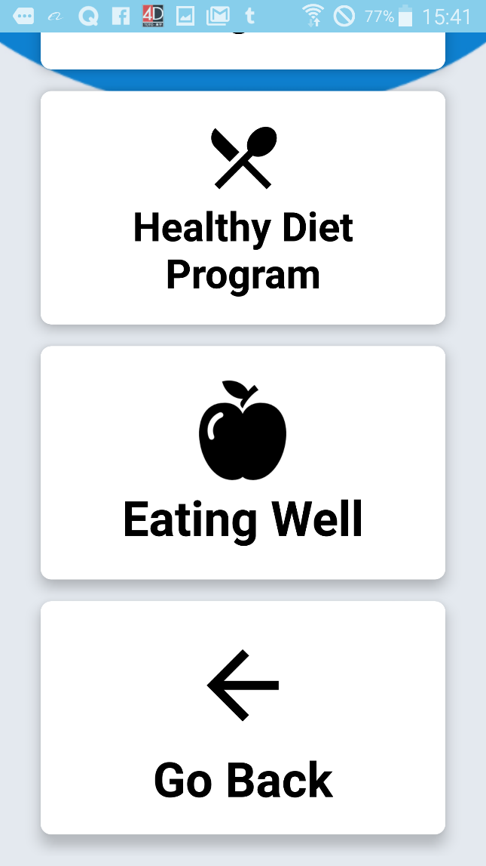
Diet Plan
In the diet plan section, users can plan their diet ahead of time so that they would be more organized. Hence, they will be more motivated to follow their schedule
In the lose weight program, they will have a guide on how to lose weight by controlling their food intake and what kind of food type they will be eating
In the healthy diet program, they will have a guide on what to eat to have a healthy diet which can help them maintain their fitness level

Slide 25
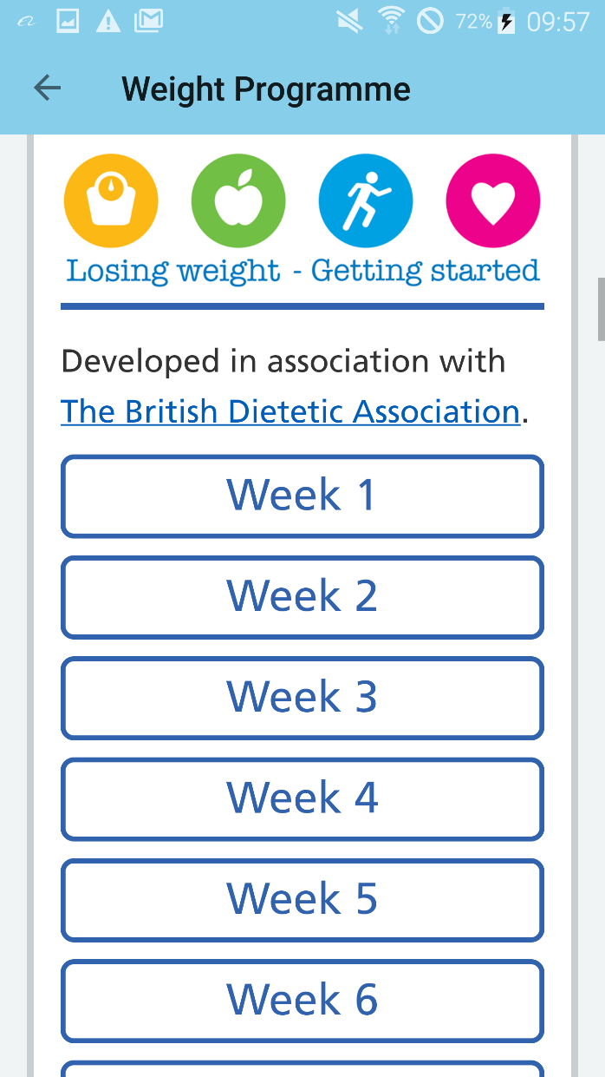
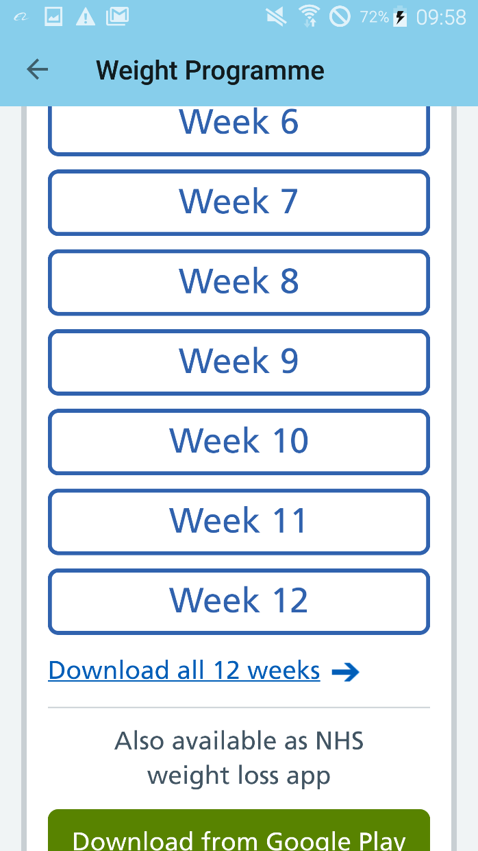
Weight programs
In the weight program, users can plan their schedule ahead of time as the application provides a weekly organized schedule
It offers a 12-weeks weight control program, we feel that this can impact and change the user’s diet as it can motivate them what to do and perform on a daily basis
If the user wants to access it quickly without opening the application, they can download the weight program in to their phone by pressing the ‘download all 12 weeks’ link below.

Slide 26
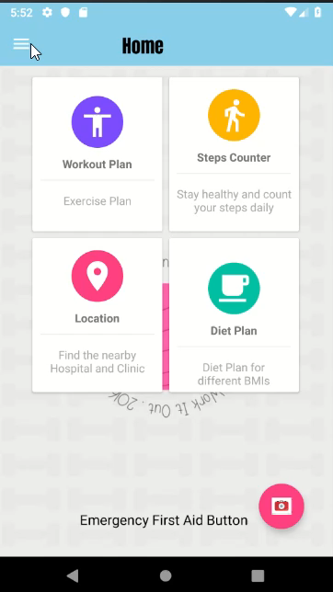
programmes
The programmes section of the application allows users to see the description of a variety of different types of activities that they can participate in different locations
Users can see the locations of where each activity is being held by selecting the location button
They can also see the specific date & time of when the activities will commence
We feel that this can help users relax and be active at the same time which will help them keep motivated

Slide 27
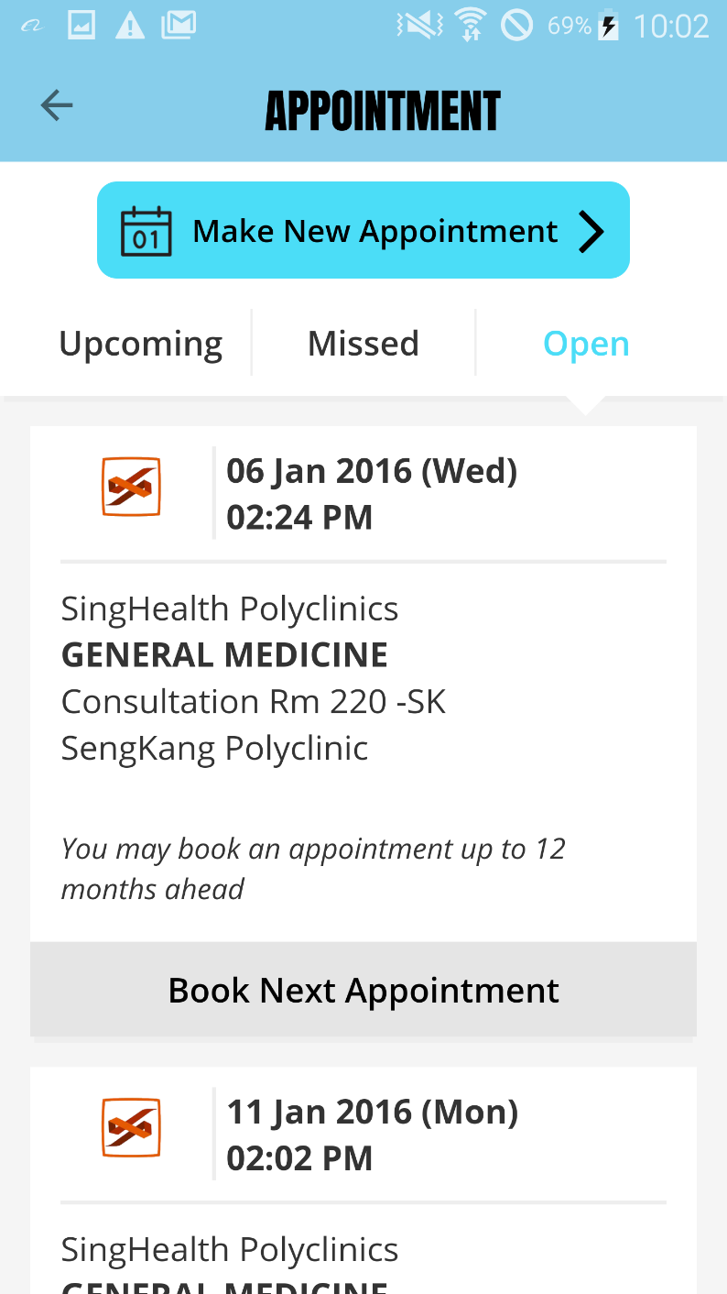
Booking an appointment
Users can book an appointment by logging in using their Sing Pass account.
They would be able to see upcoming, missed and open reserved appointments.
They can also press the make new appointment button to create a new reservation
Users can select the hospital and polyclinics they prefer
They can also select the specific date and time which can help them and be able to find a suitable timing to their schedule.

Slide 28
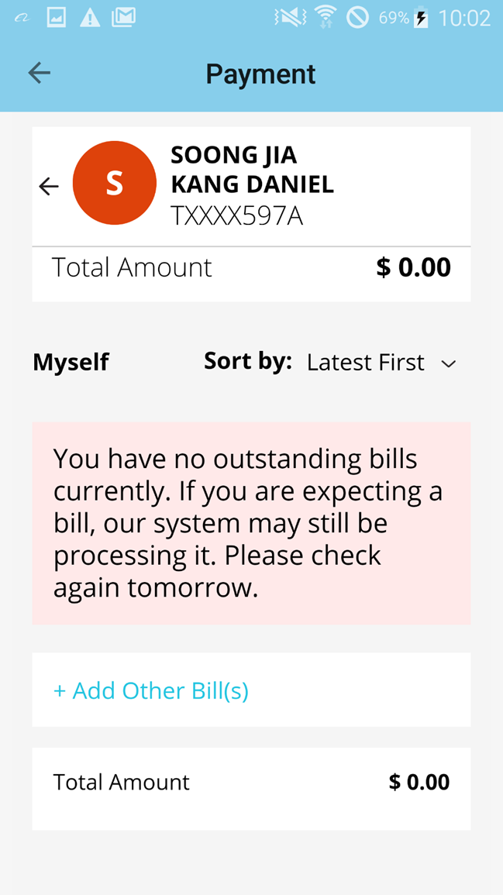
Payment for the appointment
Not only can users book an appointment using the application, they can also pay using it. Simply head to the payment section to pay the total amount for hospital consultations and other services
They can also sort their bills if they want to pay old and outstanding fees first.

Slide 29
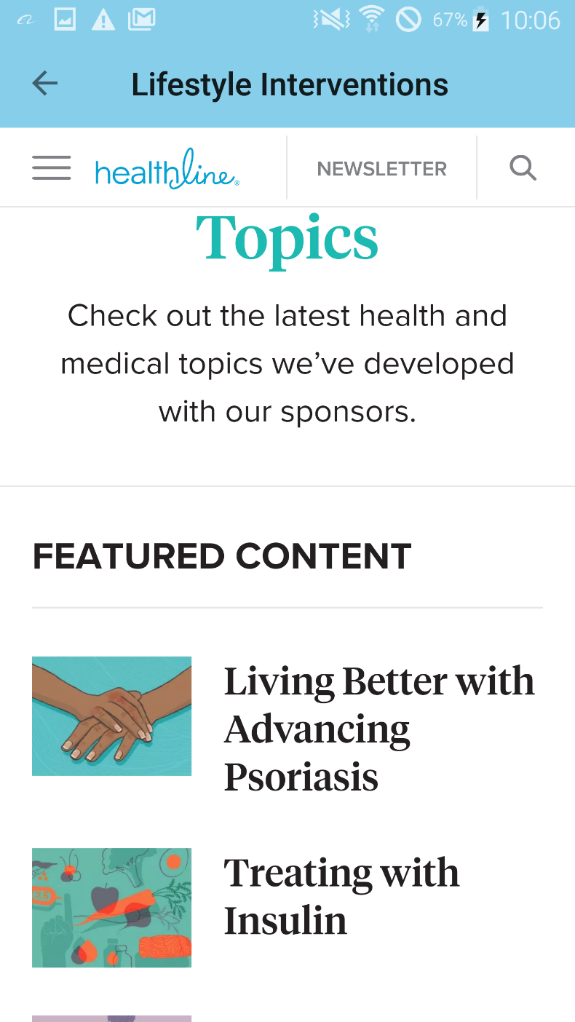
Lifestyle interventions
The Lifestyle Interventions page shows content on how to counter diseases and how to adapt and live a normal life even with illnesses such as diabetes or Hepatitis C.
By having this feature we can assure and motivate our users to have a positive mind and keep on grinding everyday to beat their sickness if any

Slide 30
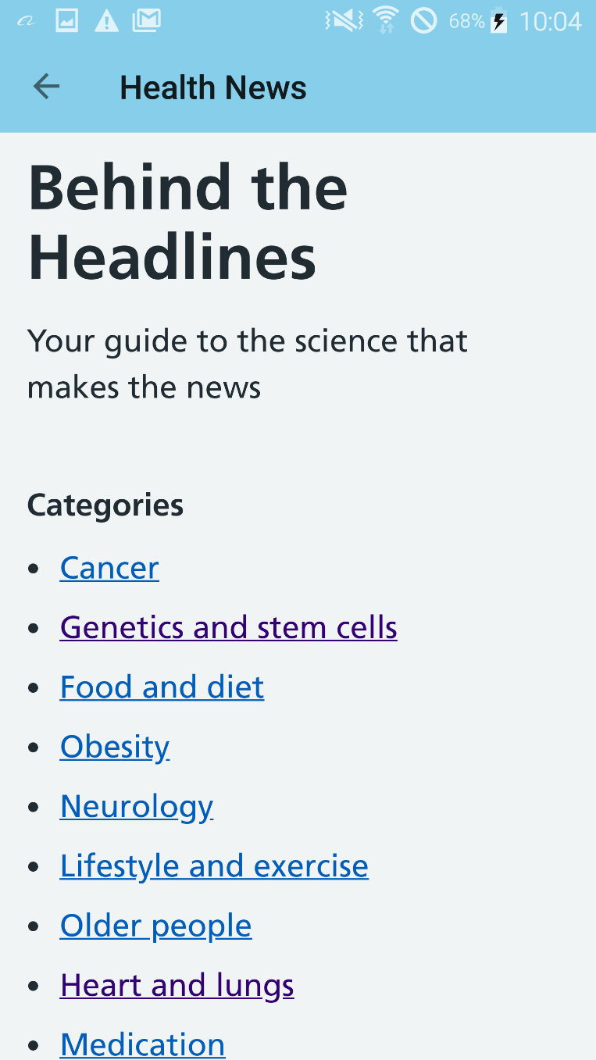
Health news section
The health news section offers users to identify and check news for diseases so that they would be updated and aware on what is happening around them
By checking out this headlines, they can find out how to prevent themselves from getting this kind of illnesses.

Slide 31
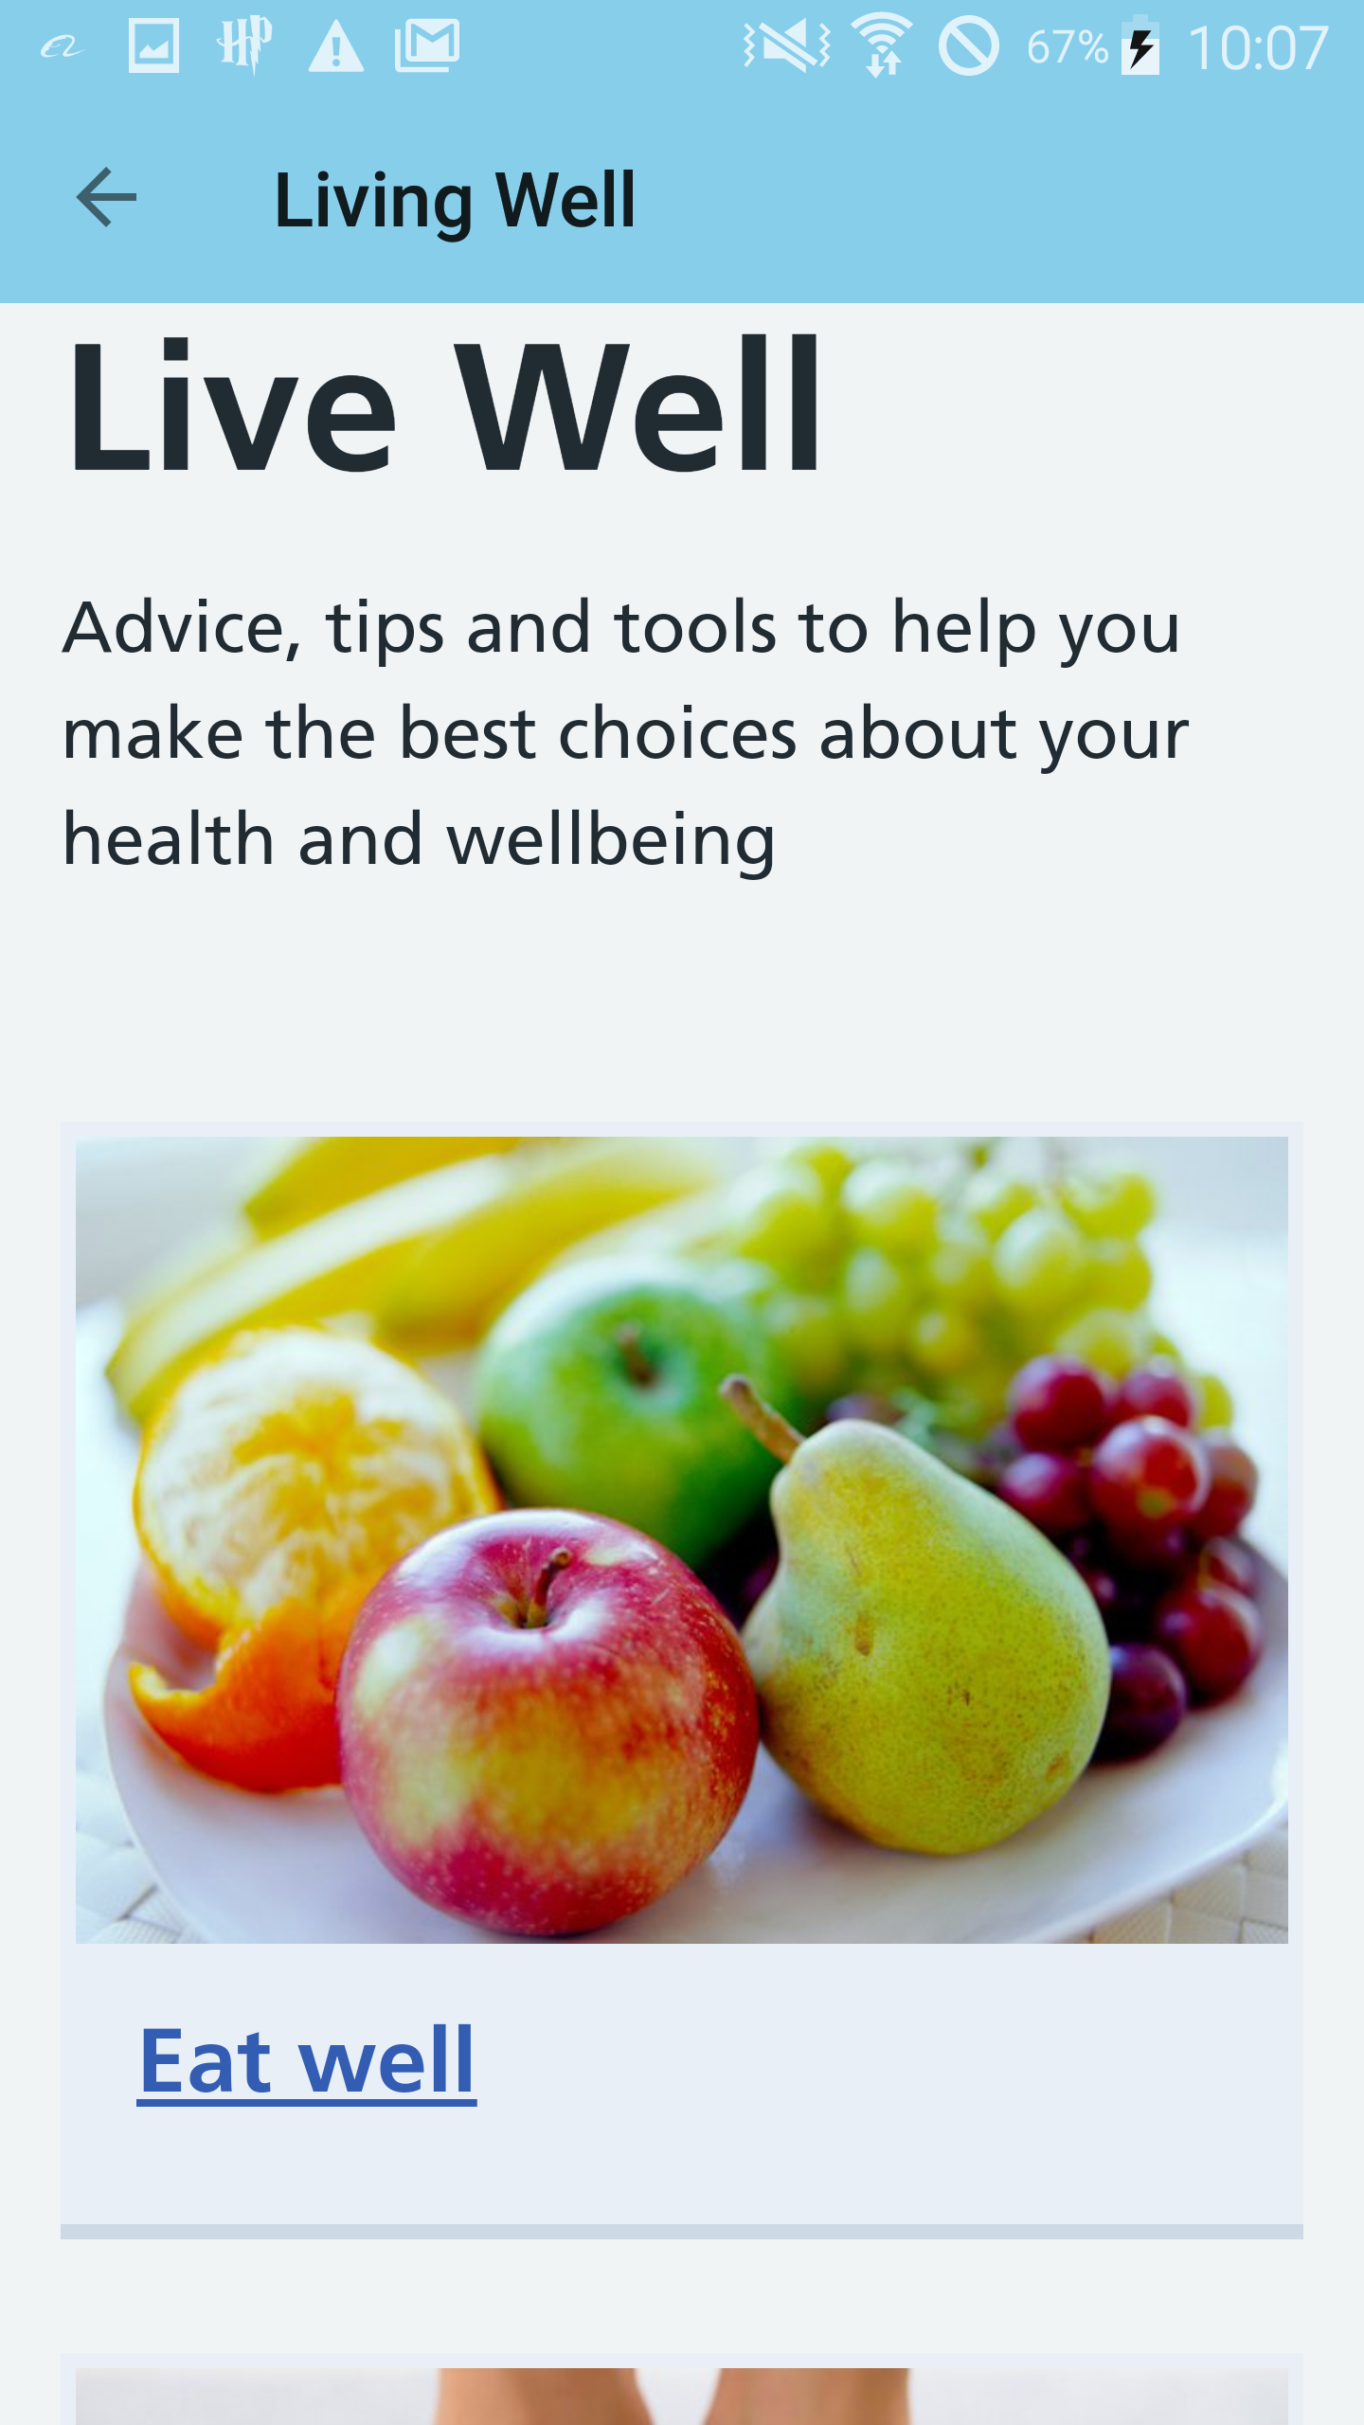
Living a better life
The Living Well page in the application shows how users the advantages of having a healthy lifestyle
It will showcase and show users that eating healthy and nutritious food can benefit the body long term
It also provides information on how to control and maintain a healthy weight so that users will control and even change their diet

Slide 32
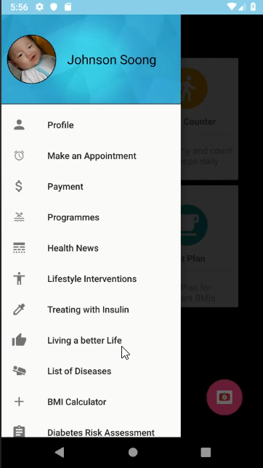
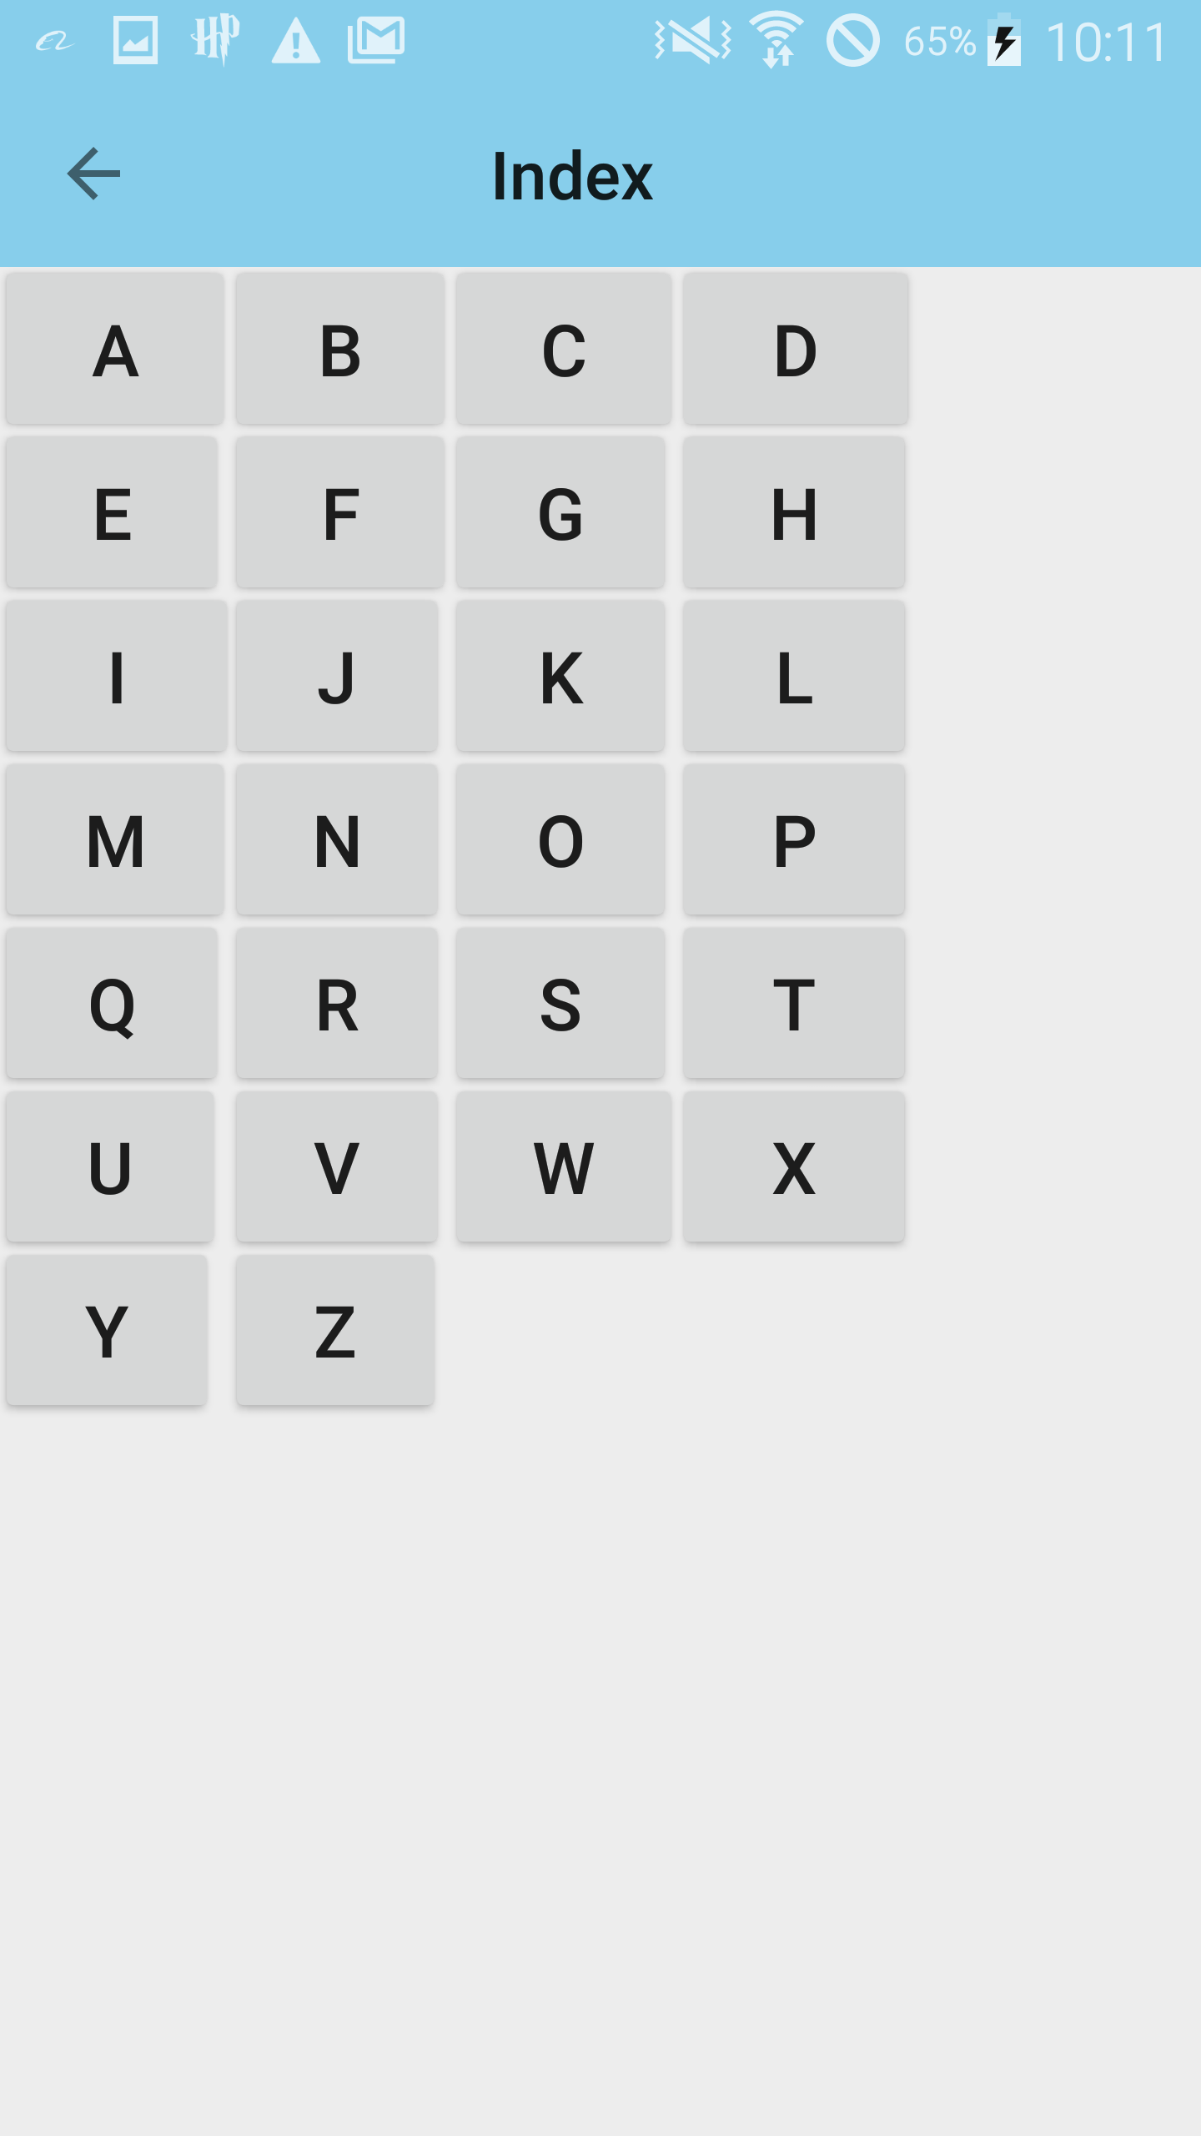
List of diseases
The list of diabetes section in the application provides access to the list of diseases common and uncommon to people. This gives them an insight of how to cure them and also know their symptoms
It also has the index feature which can speed up the process of locating a disease and illness as the user just have to select the first letter of the word they are looking for

Slide 33
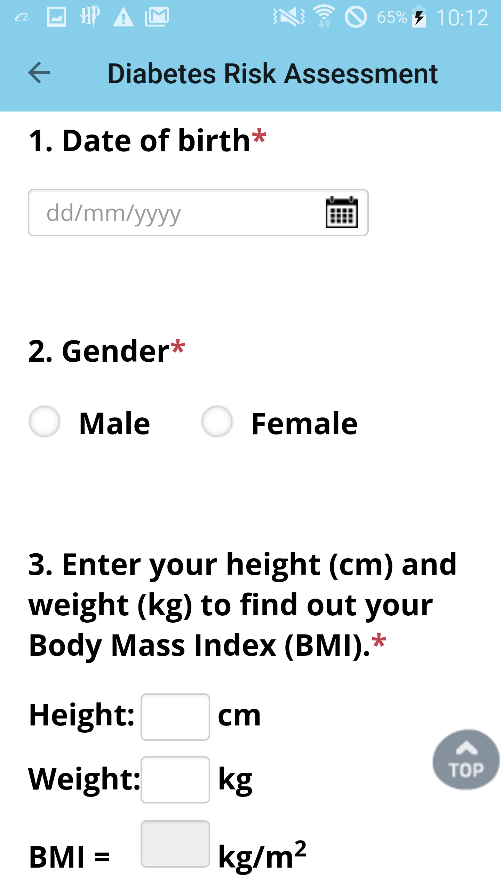
Diabetes risk assessment
The Diabetes Risk Assessment offers users to identify if they are in the risk of acquiring diabetes in the future.
They would have to fill in their personal information and their medical history
Users will then receive an E-mail if they are in risk of getting diabetes or not after they have filled and submitted the form
This is a great way of being aware and being cautious of the risk of diabetes at an early time instead of finding out in the future which may be too late

Slide 34
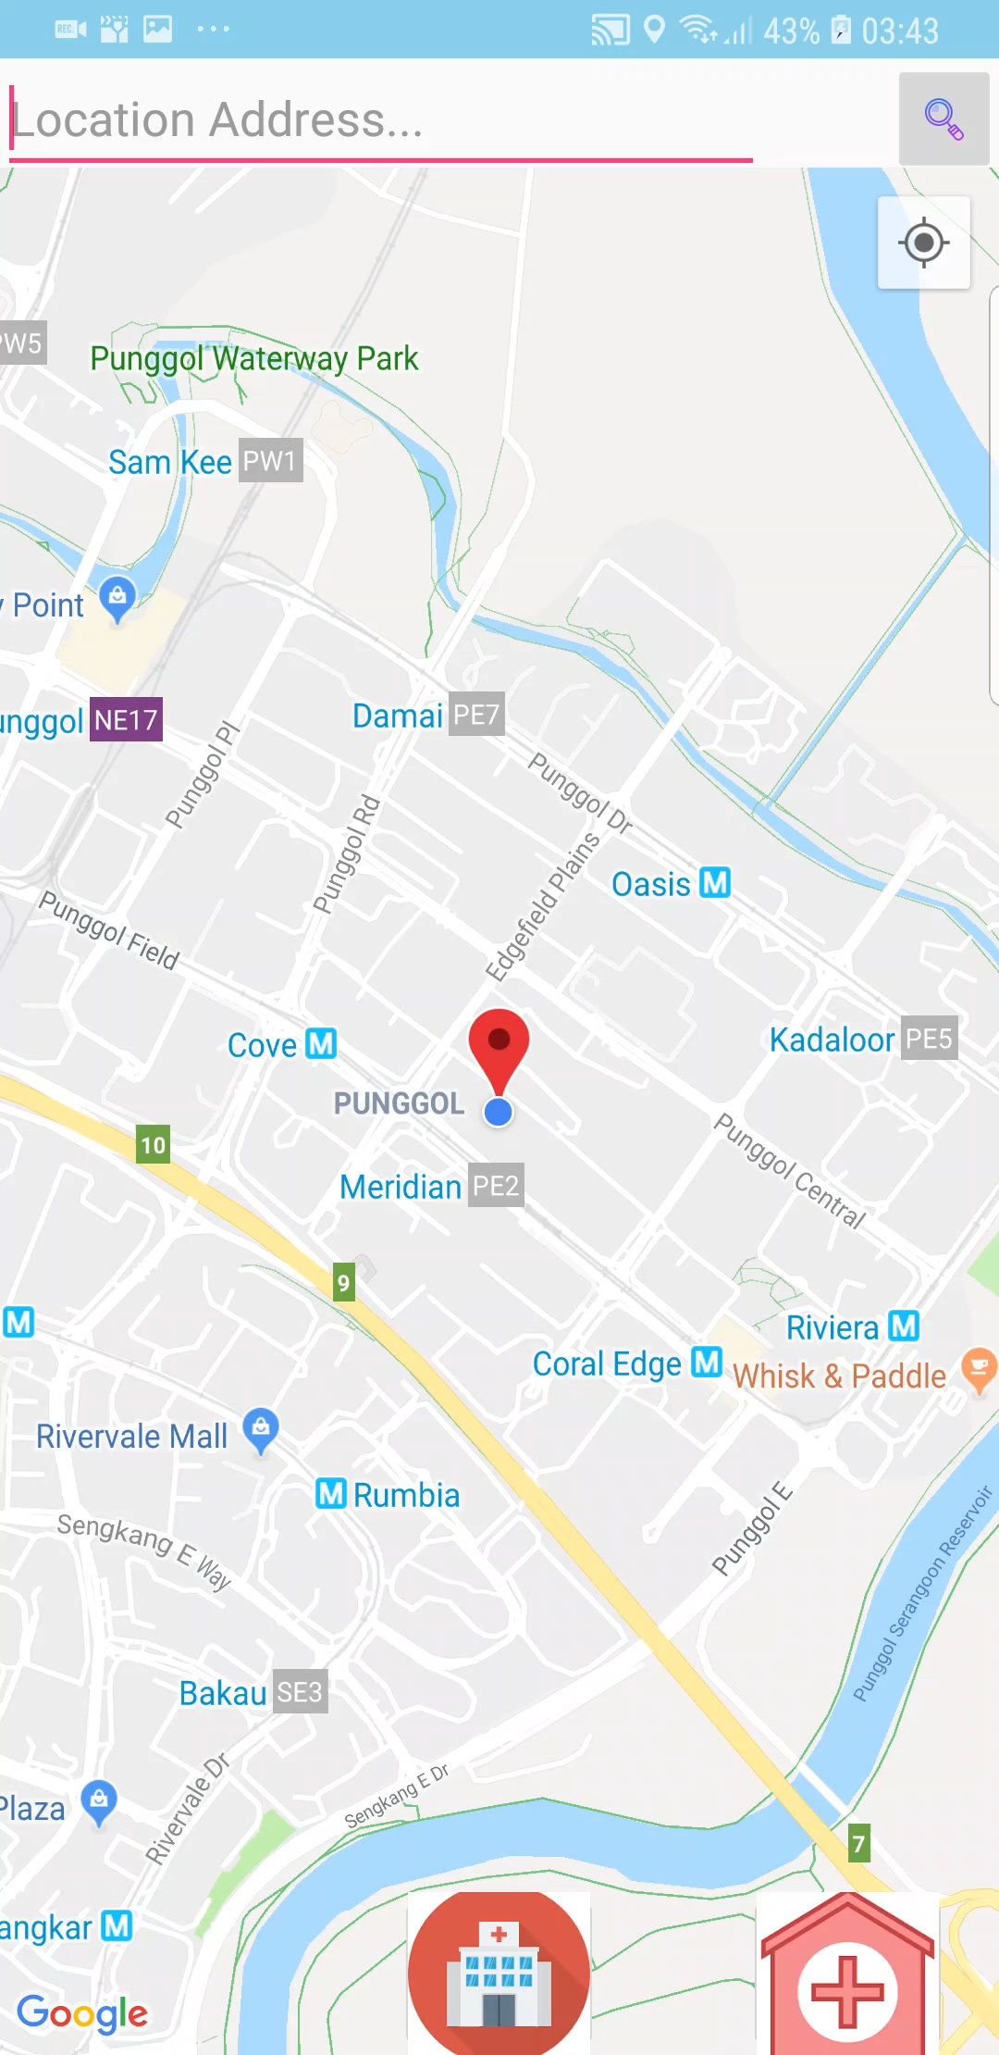
Location service
The location services that we have can further benefit users as it can locate nearby hospitals and polyclinics by pressing their logos below the page.
This is great as it allows users to find their specific address and location. In addition this feature will be critical and useful even more during emergencies that require immediate attention

Slide 35
Use cases
Use cases identify how the user will interact with the system. The use case beside captures the functional properties of the Healthees application. The Healthees application scenarios are documented instances of use case and represent a single path through the use case.
The use case model below illustrates how the users who will navigate through the application for the first time to register and login so that they can check the application for the workout plan
Welcome Page
Choose age group
Register Page
Workout Plan will be displayed
Workout Plans
Login Page
Home Page
Edit user profile

Slide 36
Use cases
The use case model below illustrates how the users who will navigate through the application for the first time to register and login so that they can check the application for the workout plan
Welcome Page
Lose or healthy diet plan
Register Page
Diet Plan will be displayed
Diet Plans
Login Page
Home Page
Edit user profile

Slide 37

How can this benefit doctors?
By booking an appointment the doctor can actually schedule their own day for the patients and plan ahead of time
It can also benefit doctors as they can check a patients medical history on the application

Slide 38
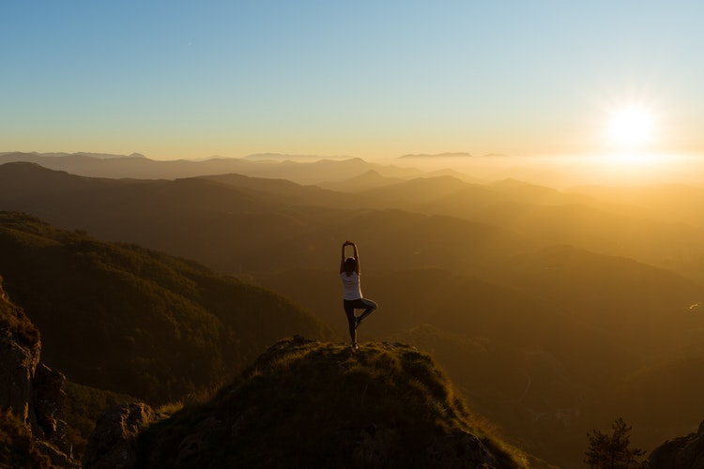
How can the APPLICATION benefit users?
The application can benefit the users as they do not have to go to the hospital or polyclinic itself and have to queue for a very long time.
Users can use the BMI calculator to get a good idea of their current fitness level to find out suitable exercises for them to do.
Users can keep track of their diet plans as the application provides a weekly guide process of their food intake.
Users can do the diabetes risk assessment to know if they are in risk of getting diabetes in the future
Users can access the list of diseases to see illnesses’ symptoms and how can they prevent themselves from getting it.

Slide 39

Ways to improve our application
We can add a link from the workout plan to Spotify so that users can listen to their favourite tunes while working out.
We can add the total distance travelled by a user in the steps counter, so that they can see how far they have ran
We can add notifications and pop-ups so that users will always be updated on their workout and diet plans
Lastly, we can add a memo section for users to fill in so that they can remember things they want to do or bring like water bottles, notebooks and earphones

Slide 40
Responsibility Matrix
S/no. | Tasks | Daniel | Radhia | Carissa | Justin | Glenn
1 | Installation Of Windows 10 | R | R | R | R | R
2 | Installation of Android Studio | R | R | R | R | R
3 | Tutorial of Android Studio | R | R | R | S
4 | Application Idea, design & layout | R | R | R | R | R
5 | Research of health websites | R | R | R | S
6 | Research of codes | R | R | R | S
7 | Schedule Management | S |  |  |  | R
8 | Weekly Updates | S |  |  |  | R
9 | Monthly Progress Report | S |  |  |  | R
10 | Welcome Page | R | R | R | S
11 | Register Page | R | R | R | S
12 | Login Page | R | R | R | S
13 | Change Password | R | R | R | S

Slide 41
Responsibility Matrix
S/no. | Tasks | Daniel | Radhia | Carissa | Justin | Glenn
13 | Home Page | R | S | S | S
14 | Application Section | R | S | S | S
15 | User’s Profile | R | S | S | S
16 | BMI Calculator | R | S | S | S
17 | Workout Plan | R | S | S | S
18 | Diet Plan | R | S | S
19 | Programmes | R | S | S
20 | Booking an Apppointment | R | S | S
21 | Payment for application | R | S | S
22 | Health News Section | R | S | S
23 | Lifestyle Interventions | R | S | S
24 | Living A Better Life | R | S | S
25 | List Of Diseases | R | R | R | S

Slide 42
Responsibility Matrix
S/no. | Tasks | Daniel | Radhia | Carissa | Justin | Glenn
26 | Diabetes Risk Assessment | R | S | S | S
27 | Location Service | R
28 | Test Run Of Application | R | R | R | R | R
29 | Feasibility Study Report |  |  |  |  | R
30 | Meeting Minutes |  |  |  |  | R
31 | Responsibilty Matrix |  |  |  |  | R
32 | Final Year Presentation Slides | S |  |  |  | R
33 | Project Scope, requirements & Analysis of applications |  |  |  |  | R
34 | Design Documents |  |  |  |  | R
35 | Writing Of Formal Report | S |  |  |  | R
36 | Final Year Presentation | R | R | R | R | R

Slide 43

What did we learn while doing the project?
We have learned to work together better as a group and individually
We have learnt a lot of things while doing and progressing through the project such as working better as a team, knowing each other’s strength in certain fields and knowing that planning is more important than performing.
We were able to communicate better with each other as we have to research information a lot while doing our project.
Our programmers have learned new codes for Android Studio. Our documenters also learnt how to write a proper report with correct English, standard font and selecting themes.

Slide 44
Conclusion
Execute & Implement
Patience & Teamwork
Communication & Understanding
Given the project task, we decided to make the Healthees application as we feel that we can help certain people that needs the motivation to be healthy or maintain being healthy, thus, we will try to provide great activities and diet plans for them to try and we also hope that they update their health particulars daily so that it will be more easier and convenient for them to keep track of their progress.
Our application will also remind users to commit and grind to their workouts and activities, as a result, this will make them motivated and determined to continue what they started. In short, we believe that the Healthees application can help and keep track of a user’s personal fitness level & health status.

Slide 45
The end Thank you ☺

